Slide 1
CDH 8.8 New Features
Feature Name- Support of Multiple Applications in Customer Decision Hub

Slide 2
Benefits of 8.8 Multiple Application Support
Serve to multiple Regions, brands, audiences within a single system.
Examples of the domains that can draw the value from this multiple support
Banks with multiple regional branches
Insurance company with multiple brands
Healthcare companies that communicate with members and providers
HDFC Australia
HDFC Turkey
Customer Decision Hub
Pega Platform

Slide 3
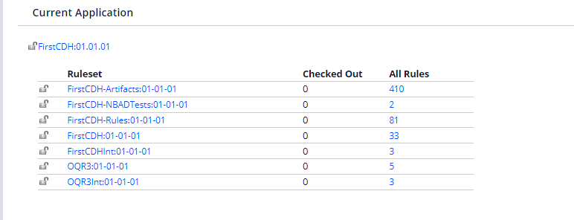
Common Settings and Best Practices in Multiple Applications and Structure of Application
By Default created rulesets when we create our application are
Application-Artifacts:01-01-01
Application-NBADTests:01-01-01
Application-Rules:01-01-01
Application:01-01-01
ApplicationInt:01-01-01
Organization:01-01-01
OrganizationInt:01-01-01

Slide 4
Each Application will have its own Context Dictionary with unique context classes and it’s own NBA Designer which would be application specific which would include
Business Structure
Constraints
Engagement policies
Events, containers, Outbound runs
The applications would be having certain system settings like
Repository(export interactions and decisions)
Channels(default email and SMS)
All the existing configurations

Slide 5
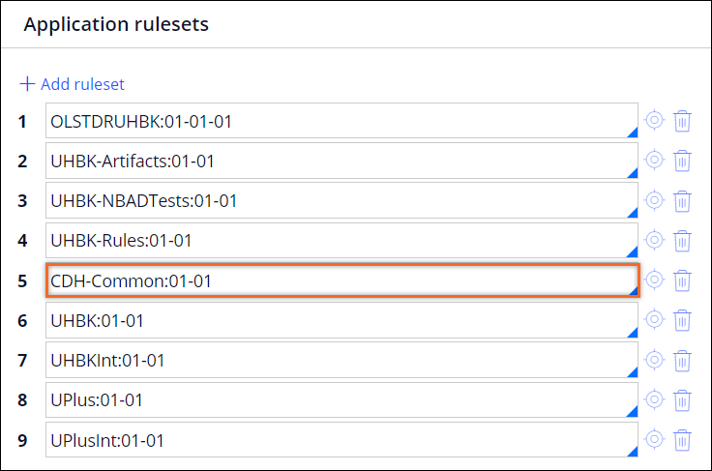
Best Practices for Multiple Applications
Before adding new application review your Pega Contractual(volume) supported.
When we run business change pipelines for two applications it would fail so should run individually since change of access groups is required.Business change pipeline is mainly used after the initial deployment through the deployment manager and the business changes done are stored under the businesschangeRM. And the changes are packaged and moved to the repository by revision manager. If failed you can restart the failed pipeline.
if we updated from 8.7 to 8.8 then there would be interaction history summaries that would have been created as part of the primary application. So we need to recreate them again in the 8.8 version under the CDH-Common ruleset and place it below the primary_application_rules ruleset

Slide 6
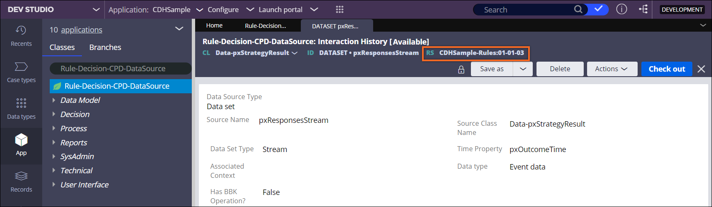
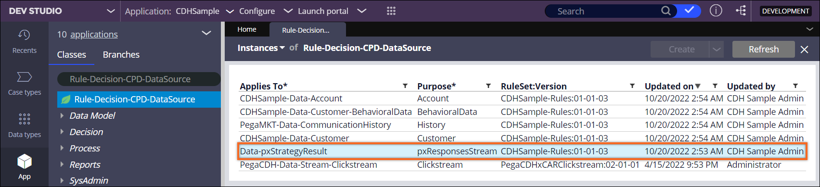
Best Practices for Multiple Applications
The output class for all the interaction histories that you created in the Profile Designer In 8.7 would be application specific so can recreate it in the CDH-common ruleset would allow it to use by multiple applications.
Open the aggregation of Interaction history and add the newly created summaries. And also we need to clean up the application specific summaries which would be under the Data-pxStratergyResult class. We can remove them from the instances of the Rule-Decision-CPD-DataSource class.
Summary of the instances also need to be removed from the Rule-Decision-CPD-Summary class. And it is stored in application specific rules ruleset.

Slide 7
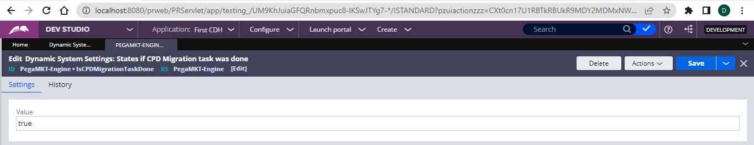
Best Practices for Multiple Applications
We need to delete remove the instances because they would not be valid for other applications. So we can use the following query to delete all the summaries
So we now we should use the IsCPDMigrationDone DSS to true to run the activity and migrate
This will run the CPD Migration Task, creates the interaction history datasource in the common ruleset and updates the profile data sources. After this in the dev studio open the interaction history and select the use system runtime context and materialized column as Yes It is recommended to materializing interaction history summaries.
And also we need to start real time data flows since we are suing events and containers. So need toconfigure the following data flow as New batch service ProcessFromEventSource. For each new application you create the system starts new data flows and by default they would be five threads. So we can go to the data flows landing page and edit the settings and change the threads so that his will free other resources also to run.
Paid Media Manager supports only one application. So you can configure in one application and use it for all paid media functionalities.
delete from rules.pr4_rule where pxObjClass = 'Rule-Decision-CPD-Summary' and pyPurpose in ('ActionOutcomesForThePast07Days', 'ActionOutcomesForThePast30Days', 'OfferOutcomeCount', 'pyIHSummary')

Slide 8
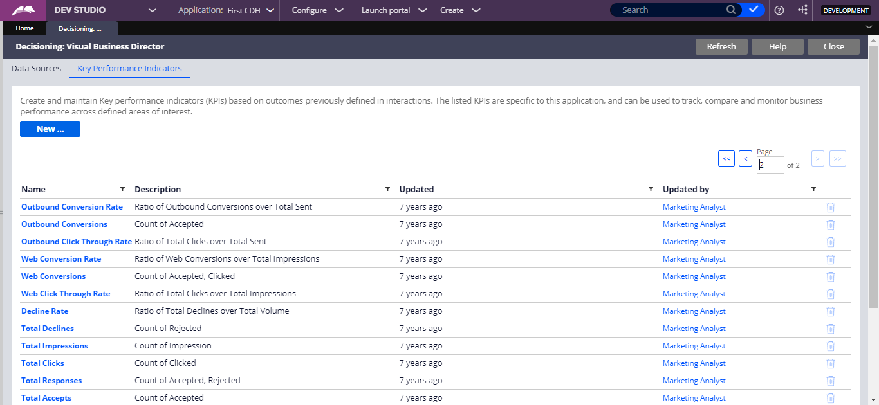
Best Practices for Multiple Applications
KPI tab in the visual business director shows the KPI’s across all the applications. Can check from Configure -> Decisioning -> Monitoring -> Visual Business Director -> KPI.
For each KPI, you can check its name, description, the time stamp, and the user name corresponding to the last change.
By default we have the Customer and Prospect and we would also have the one more Data Type called as xCar Data Model also.

Slide 9
Thankyou
By KNS Dattabhishek (A1108)

